Slide 1
Content Objective: Students will construct an argument for what kind of ethical code a machine should have.
Wed-Thur January 22nd-23rd
Recap Yesterday - Automation...Going too Far?
Gray Area Project - Building a Bot You Can Trust
Virtue Ethics
Homework
During projects only...

Slide 2
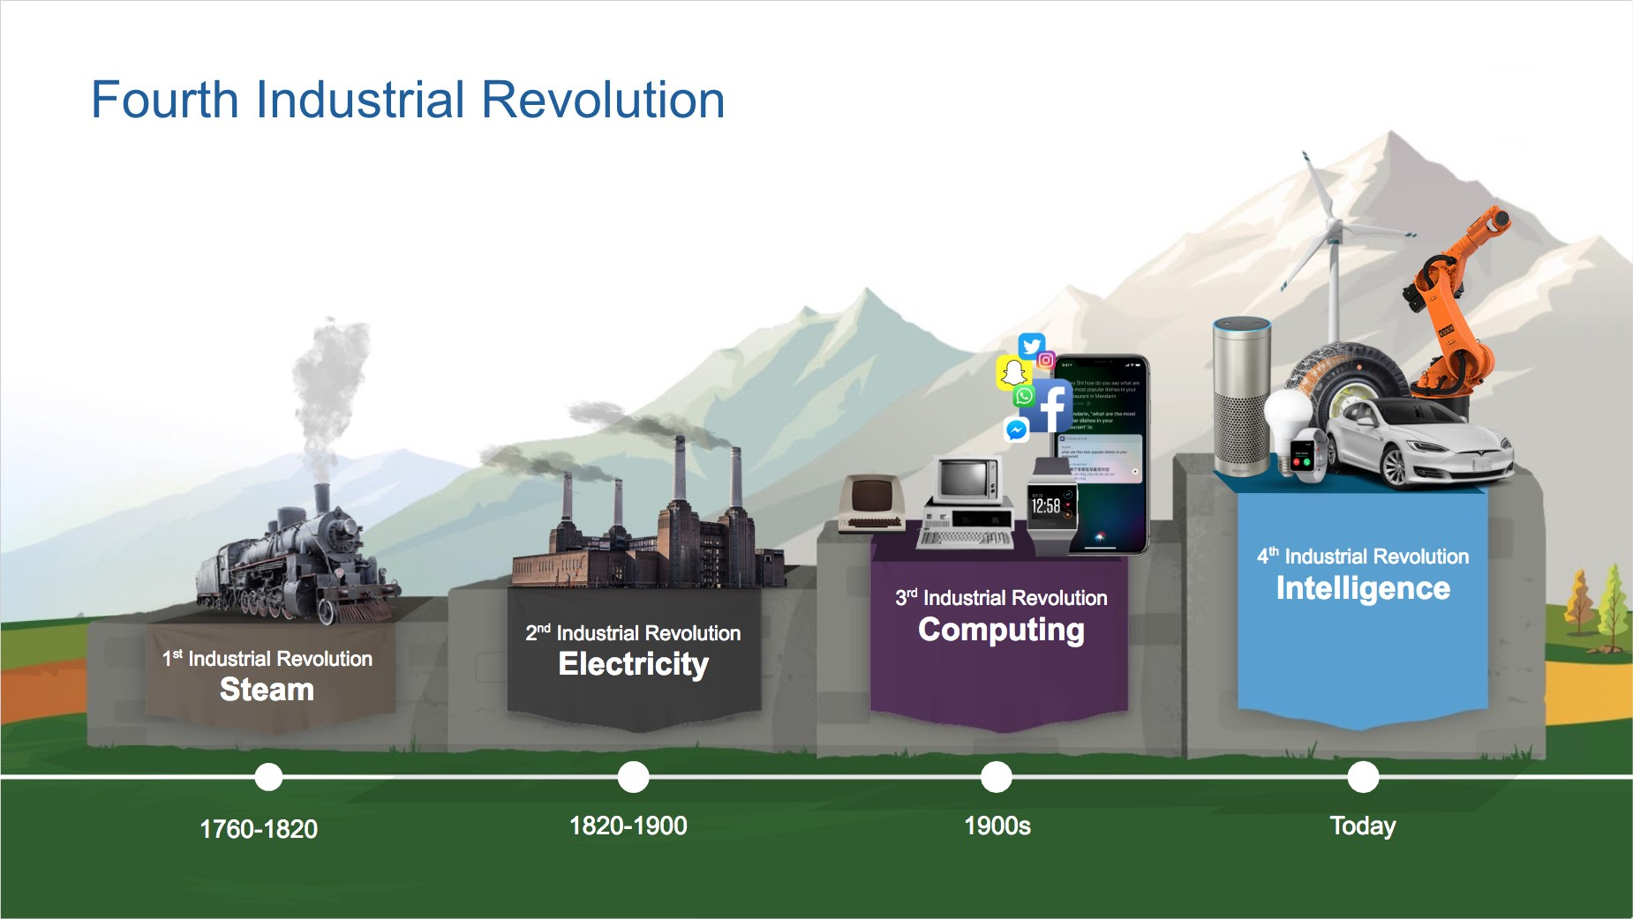
What makes the fourth industrial revolution different?
What is being automated in the fourth revolution? (what part of the body)

Slide 3
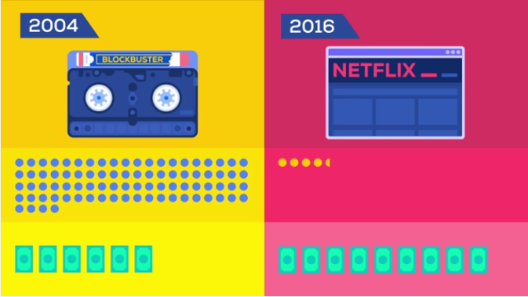
Who gets to keep their job? If your account doesn’t work...who do you call?
What are Netflix Originals?
Can you think of other examples besides Blockbuster --> Netflix?
Automation Today & Netflix 2.0
Year?
Netflix 2.0?
Total Employees?
Total Revenue?

Slide 4
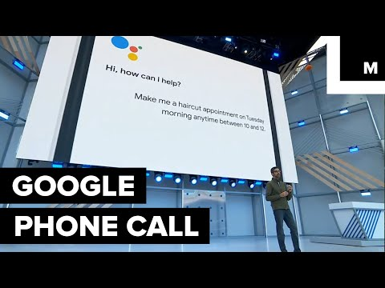
How do we get to 500 employees for Netflix 2.0?
How far should we automate everything??

Slide 5









A.I. Decides Your Job

Slide 6

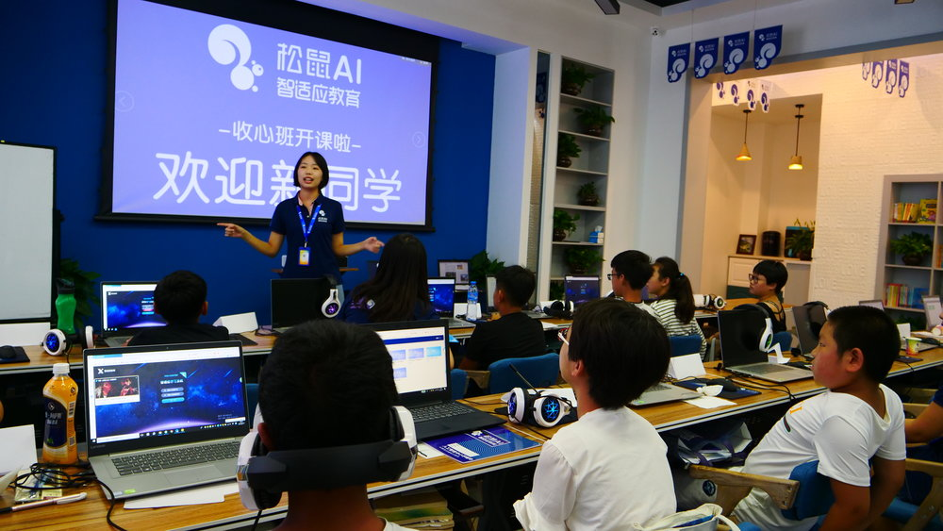
A.I. Teaches You

Slide 7
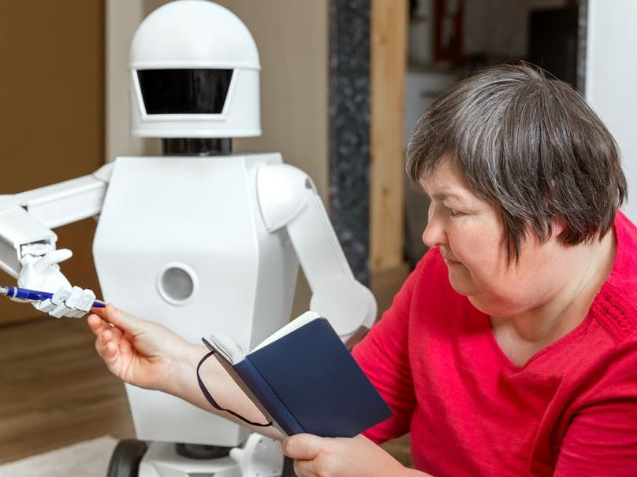
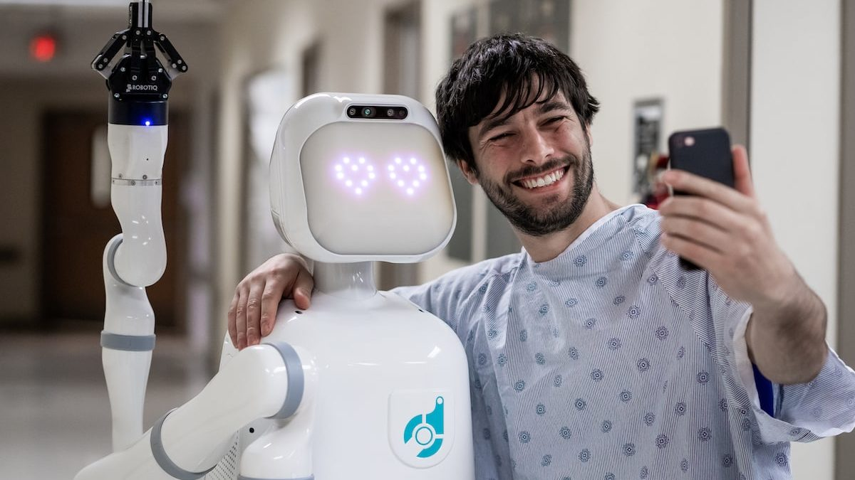
A.I. Takes Care of You

Slide 8
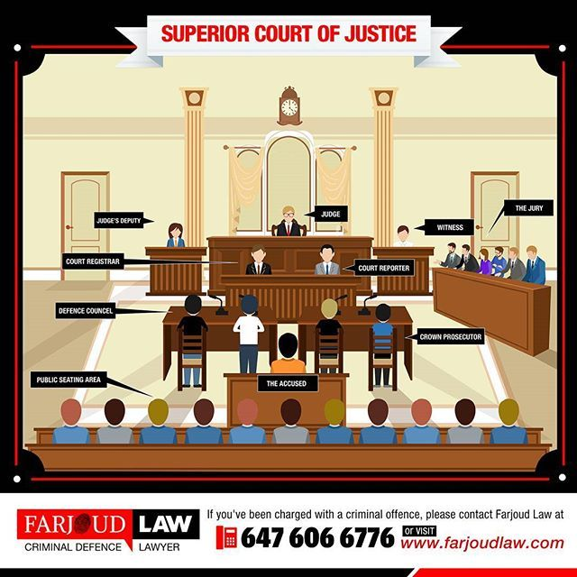
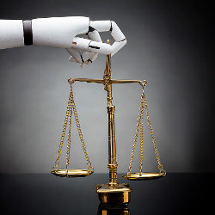
A.I. Decides if You
Deserve to Go to Jail

Slide 9
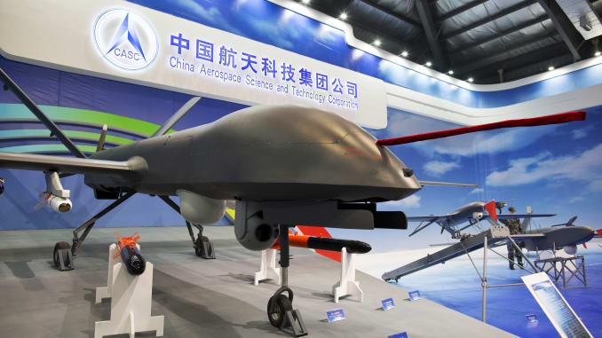
A.I. Decides if You Live or Die

Slide 10
But who builds the A.I.?
How do we build an A.I. /
Robot that we can trust?
Ethical Code Activity
Gray Area Activity

Slide 11
Ethical Code Activity
“Ethics of You”
Ethical Data Gathering
Let’s gather data on the classrooms ethical beliefs.
Slavery, Cars, Police, Art, Hitler, Killing, Drugs
Evil
Neutral
Good

Slide 12
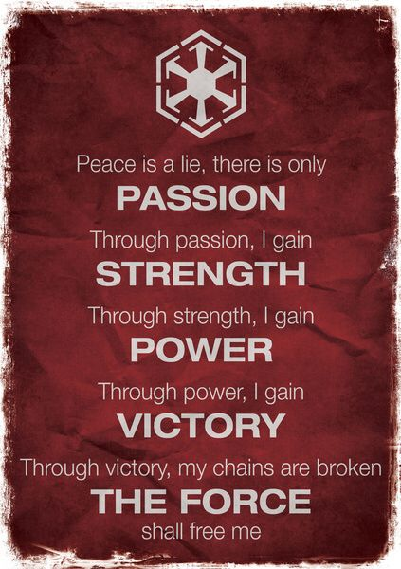

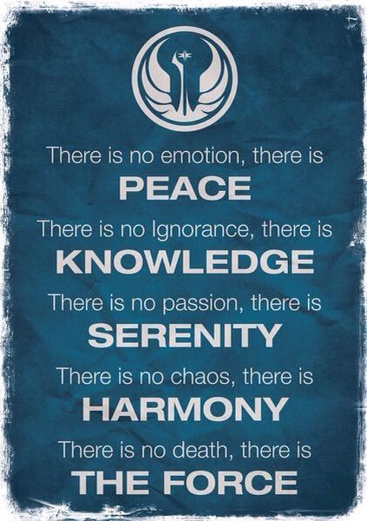
Gray Area Project
Sith - “Evil”
Gray Jedi
Jedi - “Good”

Slide 13



What is meant by “gray” ethics?
Is life black and white? Or more gray?

Slide 14

“Gray” Ethics
(Gray Jedi Code)
Has a Real Name - Virtue Ethics

